Slide 1
Image Captioning

Slide 2
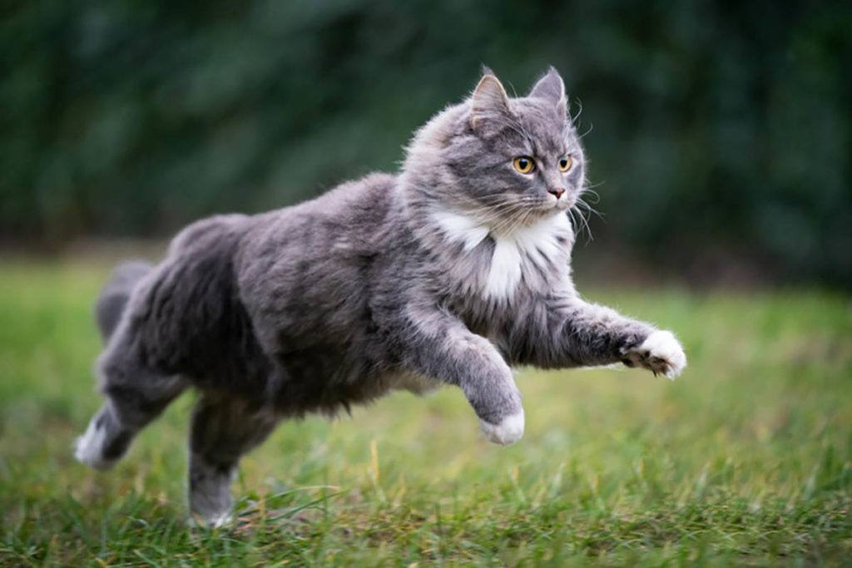
What is a Image captioning
What do you see in the image?

Slide 3
Real world applications
Aiding the Visually Challenged
Self-Driving Cars
Image Search
Web Development
Security and Surveillance

Slide 4
Data & Metrics
Data - The COCO (Common Object and Context) dataset contains 120K images with respective captions. It is a very diverse dataset with multiple captions for an image. https://cocodataset.org/#download
Metrics – The evaluation metric for image captioning is the BLEU score. The BLEU score is a number between zero and one that measures the similarity of the machine-generated captions to a set of reference captions. The score considers the matching n-grams between the reference and the generated captions.

Slide 5
Data preprocessing
1) Image Preprocessing – Decode the image, Resize the image, Image augmentation
2) Text Preprocessing – Text cleaning, Inserting start and end tags, vectorizing the text.
3) Train and validation split – Creating dataset with image and text into train and validation split

Slide 6
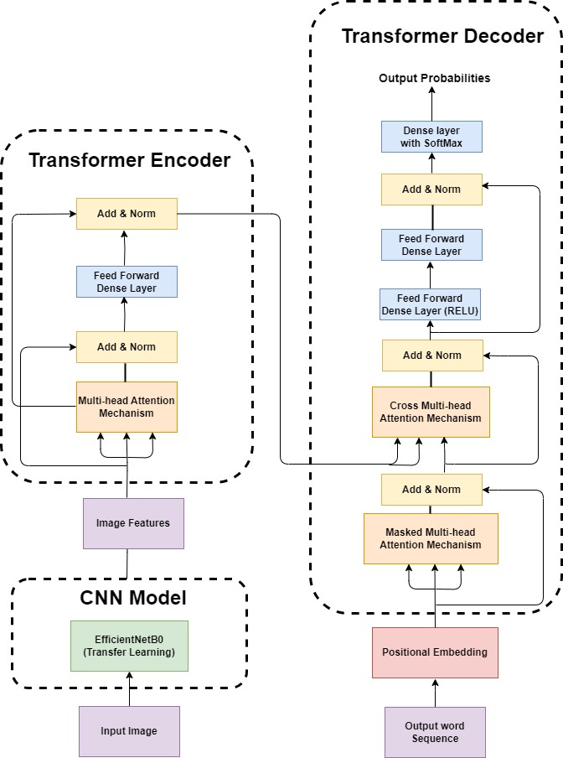
Model - Architecture

Slide 7
Generating Captions
Output text
Append the decoder output with the input token. Iterate till the <end> tag is reached in the output
CNN Model
Transformer Encoder
Transformer Decoder
Initial Token <start>

Slide 8
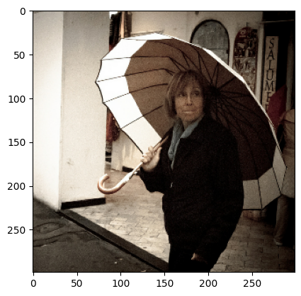
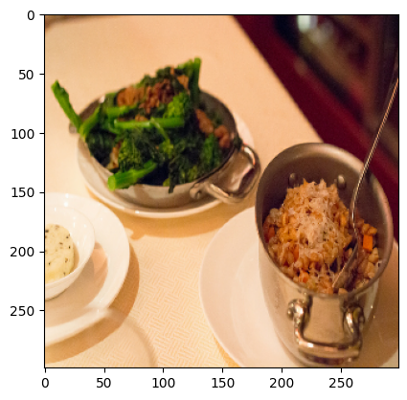
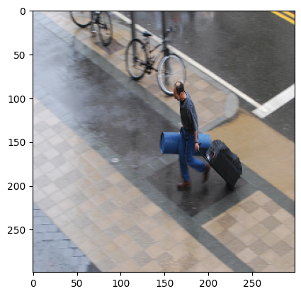
Sample Captions
a woman holding an umbrella in front of a building
a plate of food with a fork on it
a man is carrying luggage down a street

Slide 9
Conclusion

